Slide 1
Take out a piece of paper and write about one of the following questions
What is water made of? Draw the structure of the molecule.
What is denser? Liquid water or ice?
How does water stop the earth from getting too cold or too hot?
Write three unique properties of water.

Slide 2
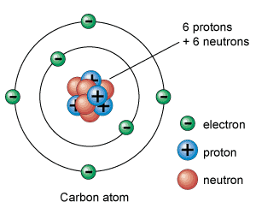
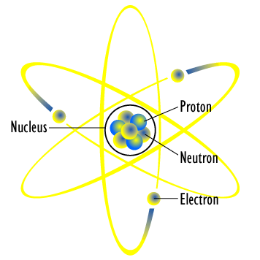
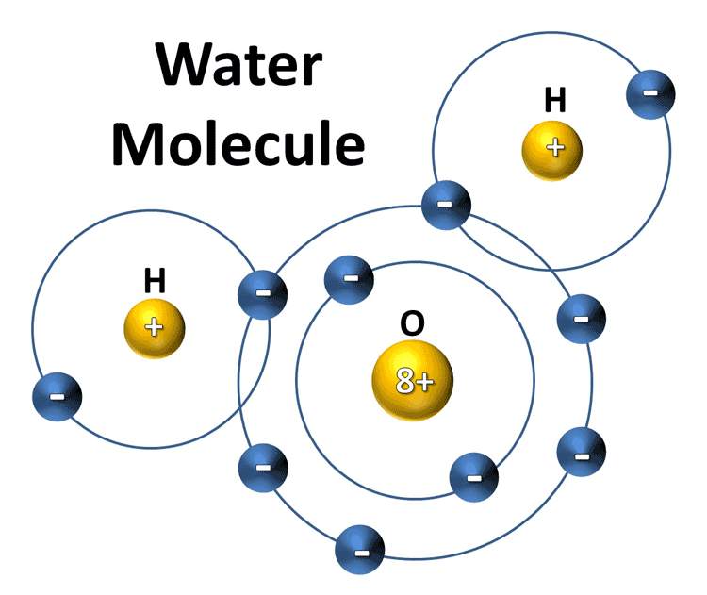
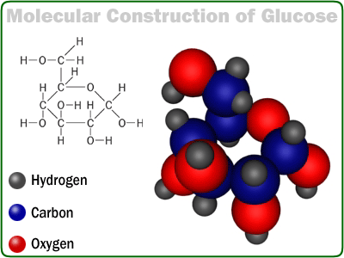
Building blocks in chemistry
Simpler components BOND to create more complex structures
The basic unit of matter is:
AN ATOM
Atoms bond together to form MOLECULES

Slide 3
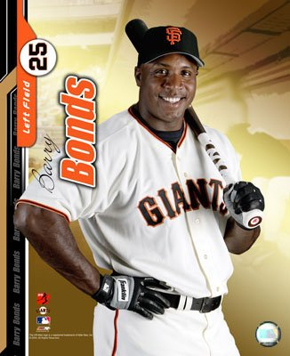
Bonds!
Ionic bonds- transfer of an electron from one atom to another
Covalent bonds- sharing of electron pairs between atoms

Slide 4
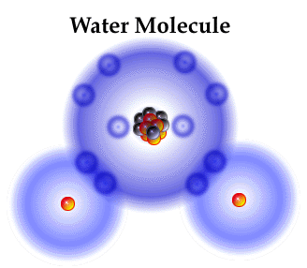
Water is everywhere
Makes up 50-95% of the weight in living organisms
Water’s structure and composition make it unique
H2O- What does this mean?
2 hydrogen, 1 oxygen atom
Unique properties
Ice is less dense than liquid water
Universal solvent
Absorb a LARGE amount on heat…
What kinds of bonds are present in a water molecule?

