Slide 1
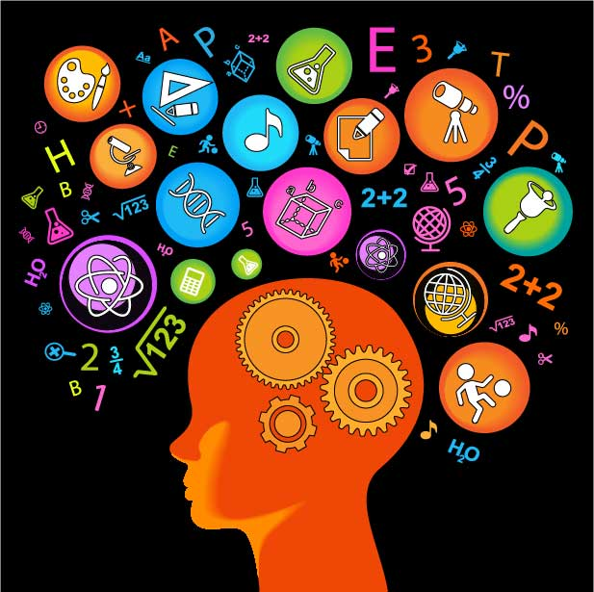
Who cares about science?
EVERYONE!

Slide 2
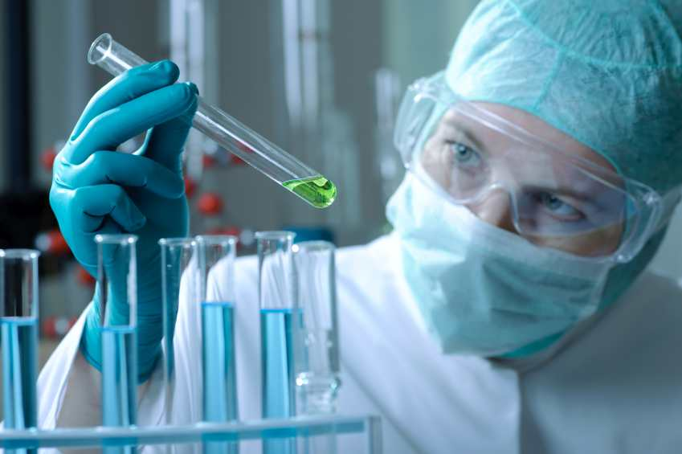
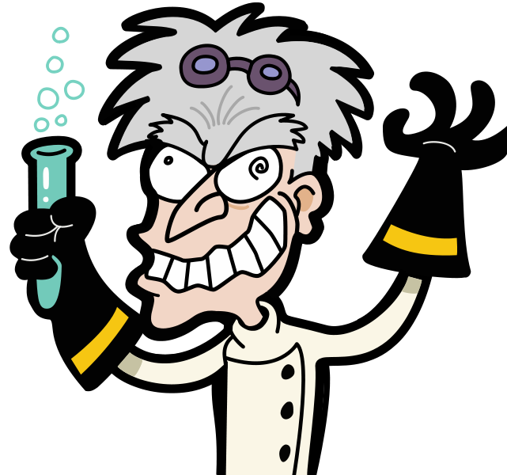
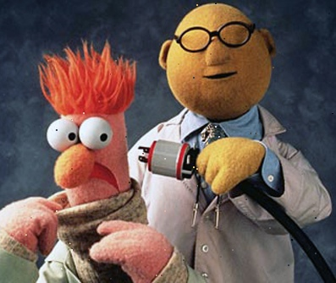
Who does science?

Slide 3
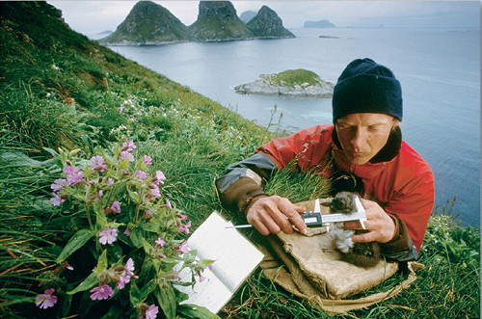
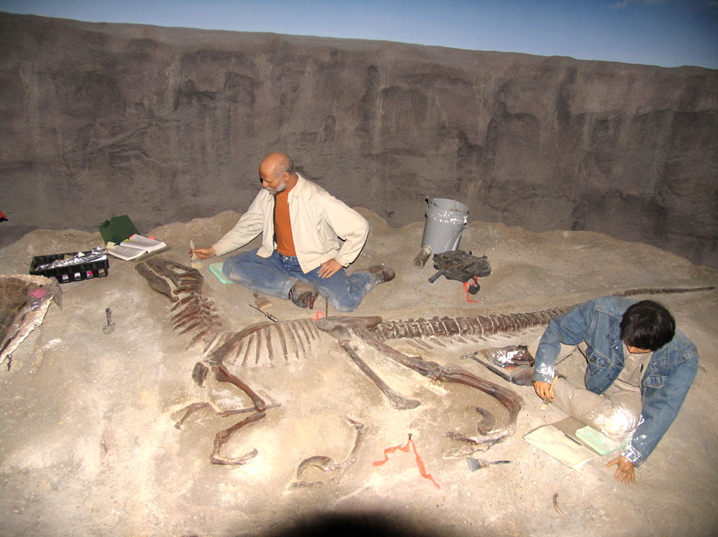
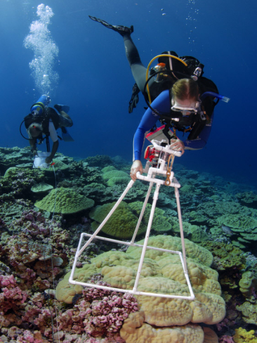
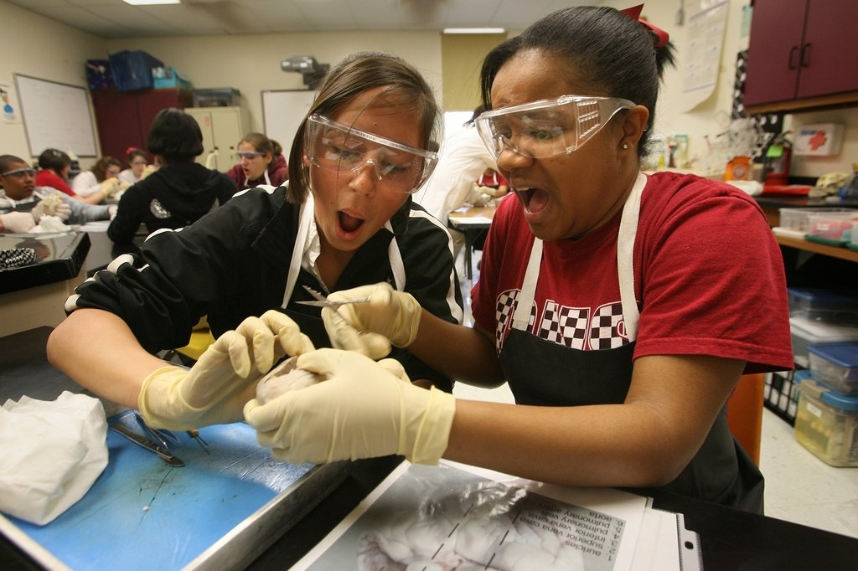
Not all scientists wear lab coats!

Slide 4
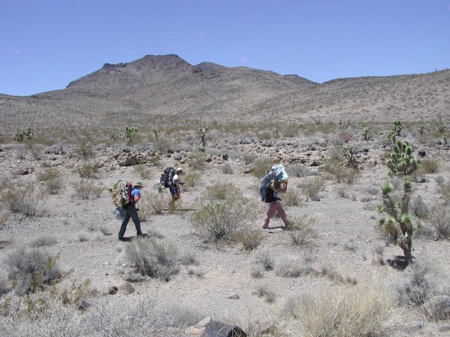
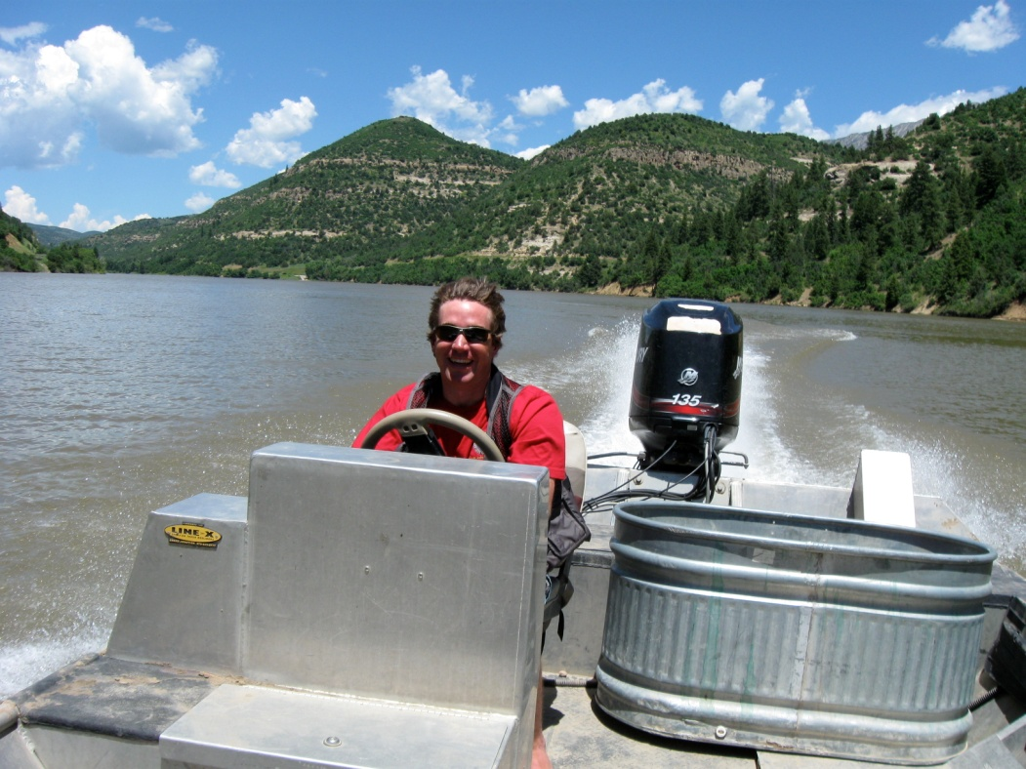
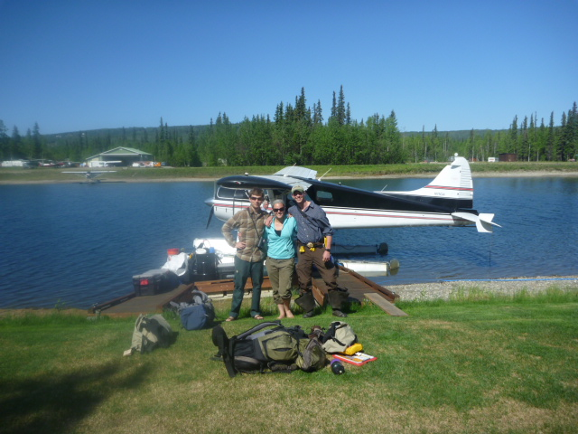
Science can lead to adventure.

Slide 5
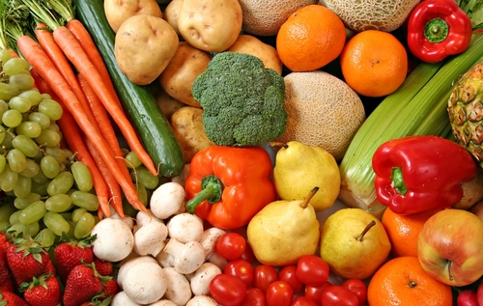
Scientific reasoning is what makes us human.

Slide 6
What does science mean to you?
“The scientific research enterprise is built on a foundation of trust.”
-On Being a Scientist (Cicerone et al.)
Scientific ethical code
Three core values
Searching for uncertainty
Recognition of ambiguity
Learning from failure

Slide 7
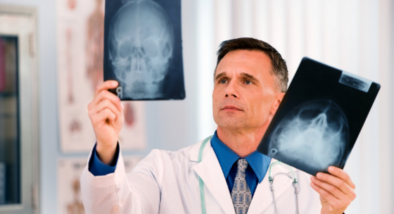
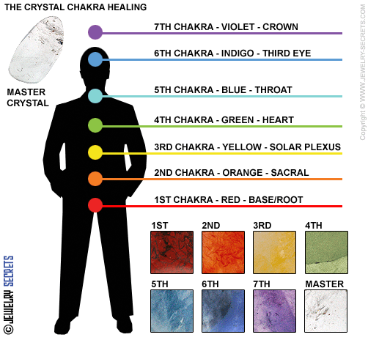
So is this science?

Slide 8
