Slide 1
Earth Day!
And Why should I care?

Slide 2
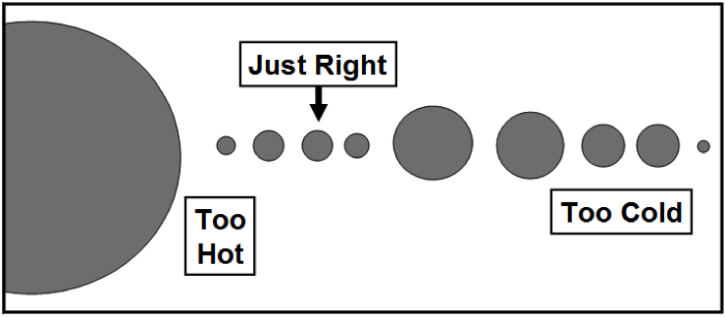
“Goldilocks Principle”
The position of the earth is important
http://curiosity.discovery.com/question/what-is-goldilocks-principle
The secret is WATER
Atmospheric composition is optimal, position from the sun is optimal

Slide 3
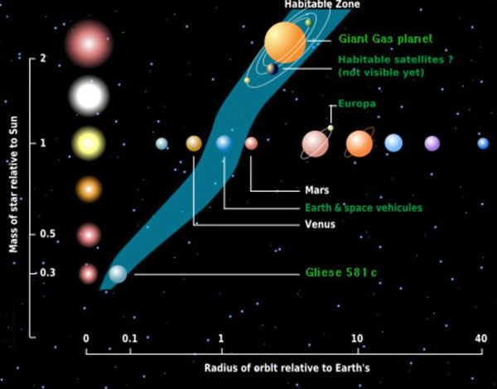

Slide 4
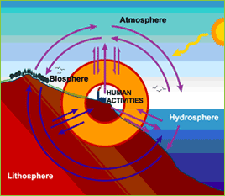
So Earth is something special
4 “spheres”
Atmosphere
Hydrosphere
Geosphere
Biosphere
Functions through natural law
Regenerative processes (if given enough time and resources)
Humans have influenced all of these spheres
Can you think of a few ways human have impacted the biosphere, geosphere, atmosphere, and hydrosphere?

Slide 5
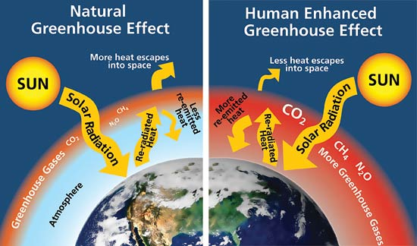
Changes to the Atmosphere
“Greenhouse Effect”
Trace gases in the atmosphere “trap” heat and retransmit it back to the earth

Slide 6
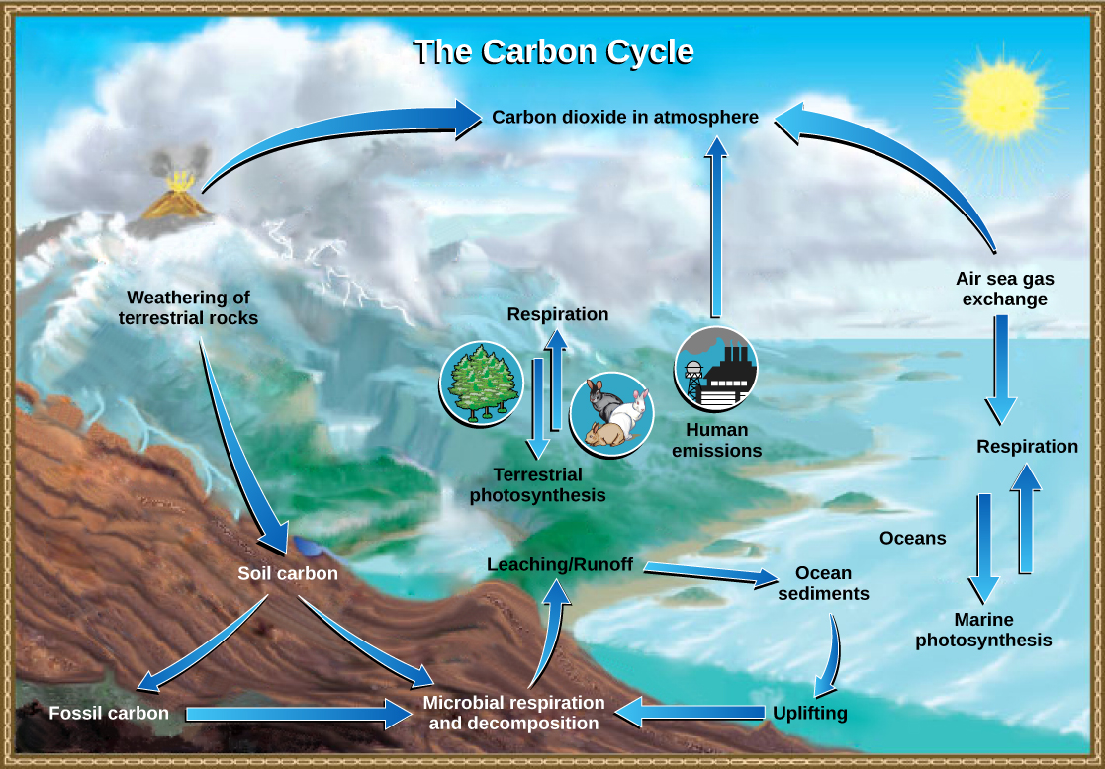

Slide 7
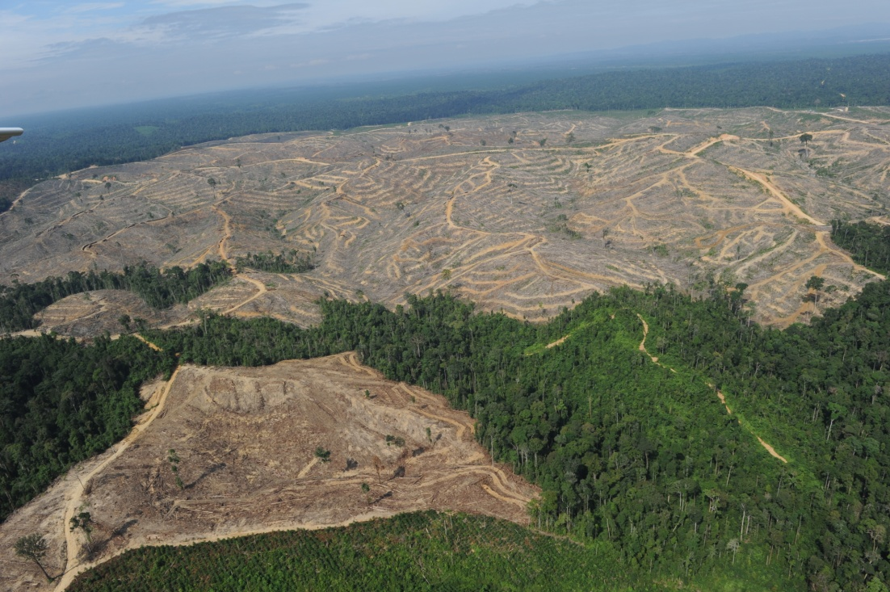
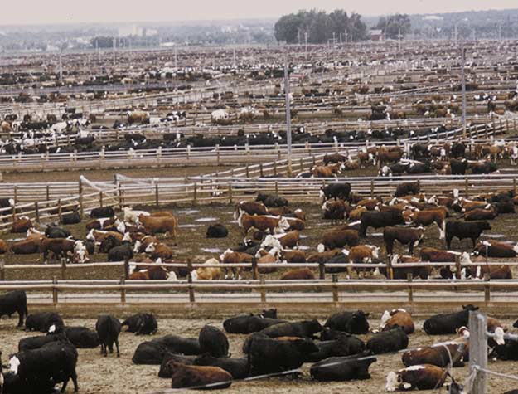
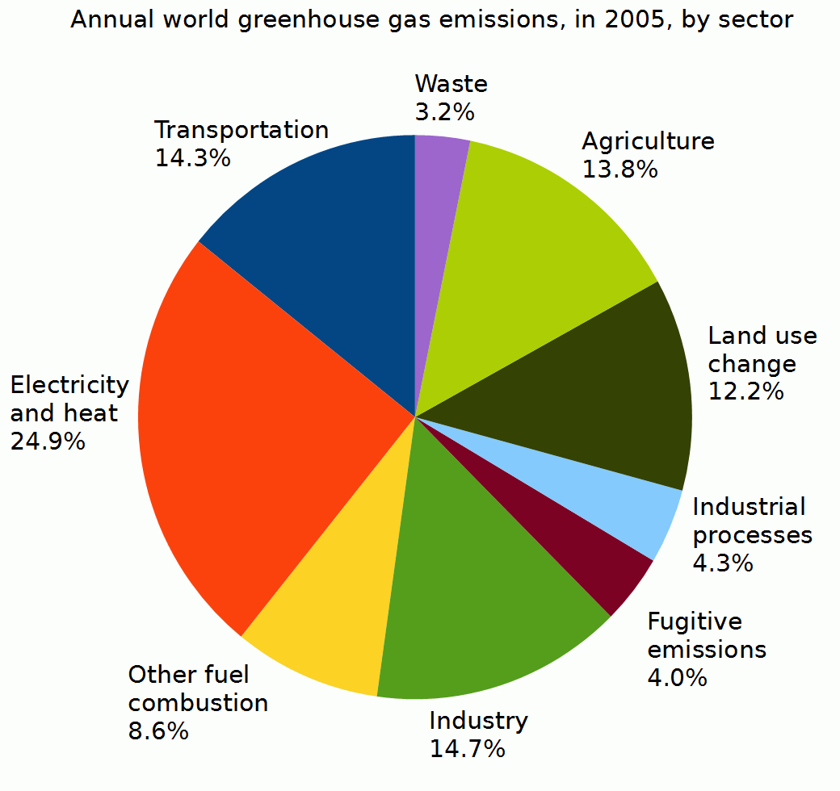
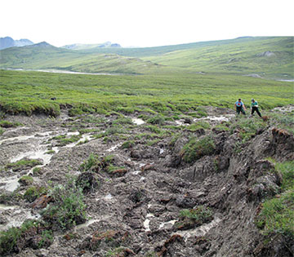
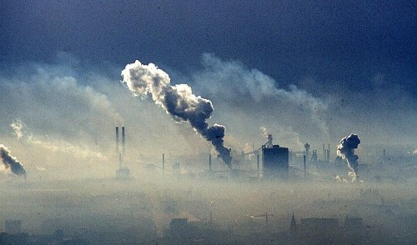
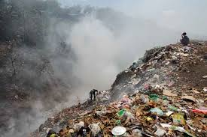
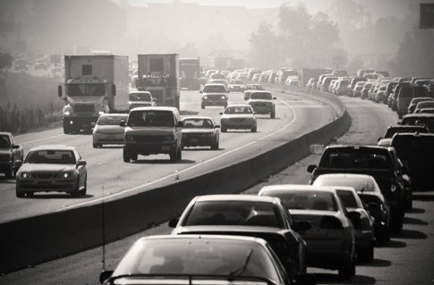

Slide 8
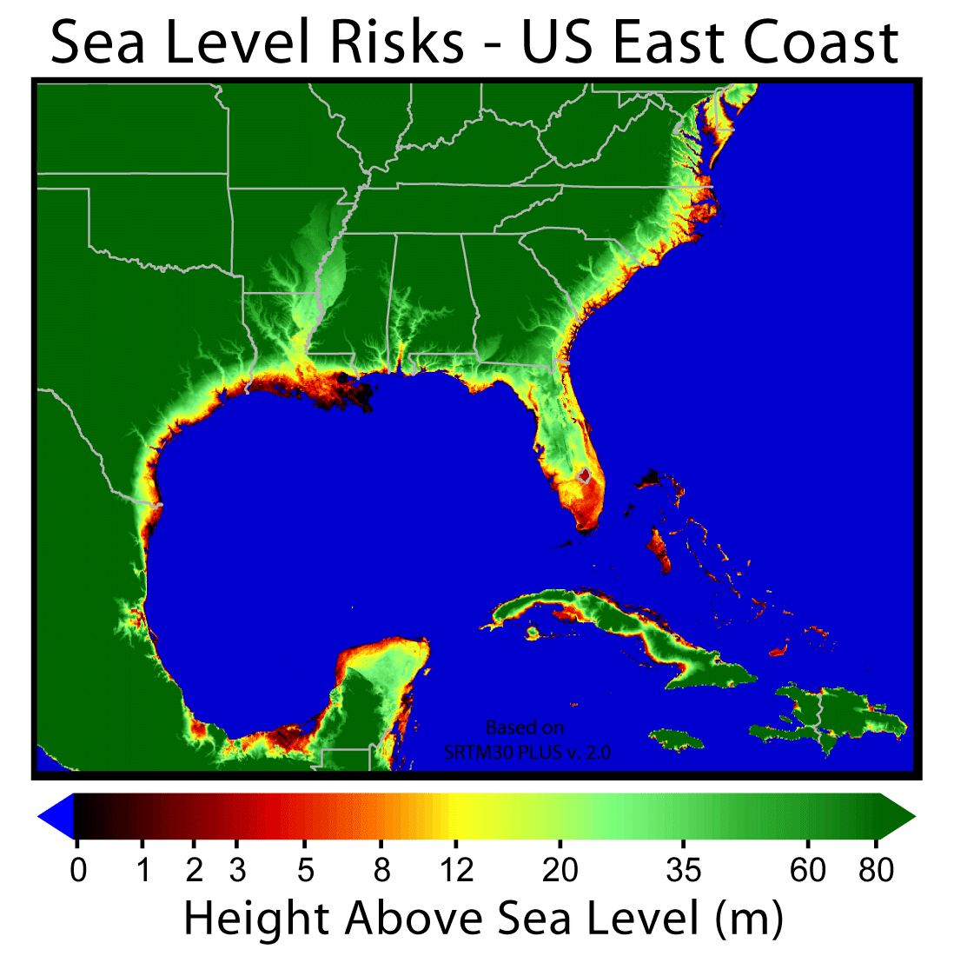
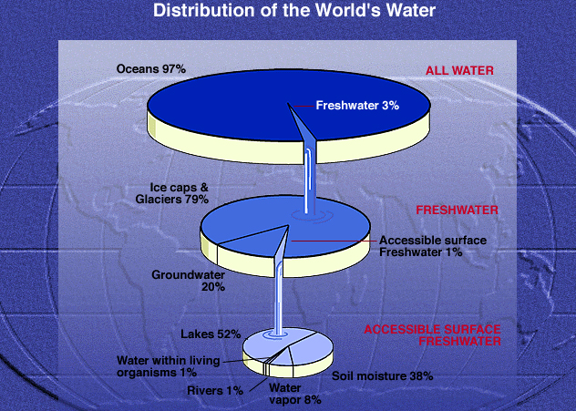
Changes to the Hydrosphere
Fresh water is a BIG concern
Sea level rise

Slide 9
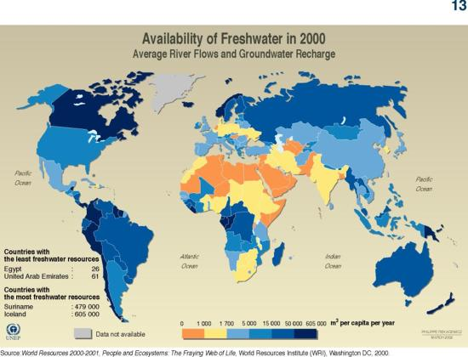

Slide 10
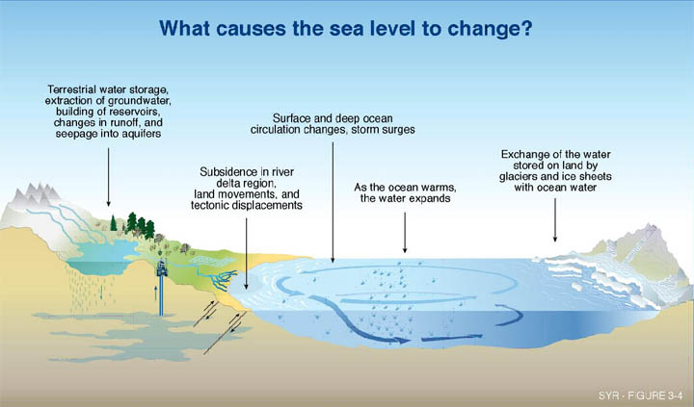

Slide 11
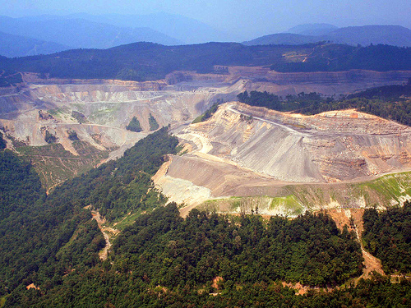
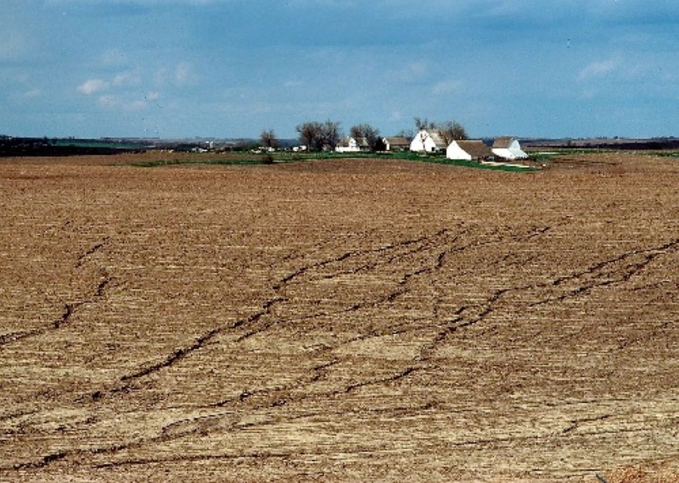
Changes to the geosphere
Mineral extraction
Soil pollution and acidification
Humans mostly at the mercy of geological forces

Slide 12
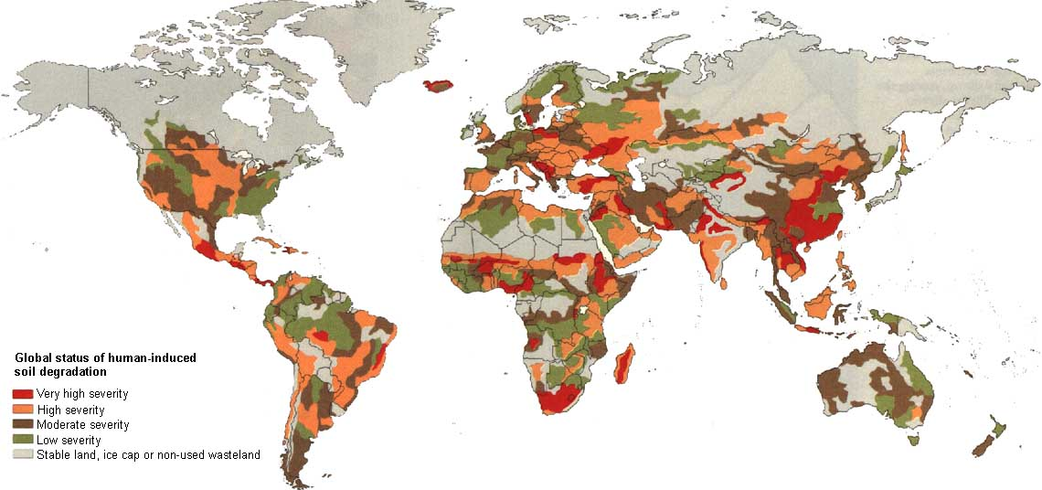

Slide 13
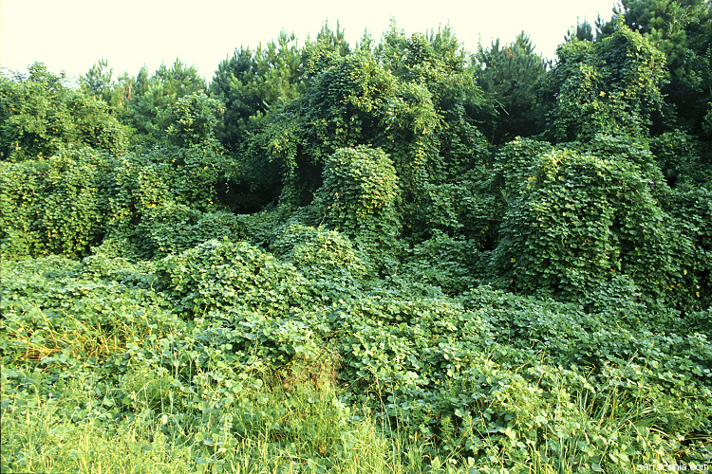
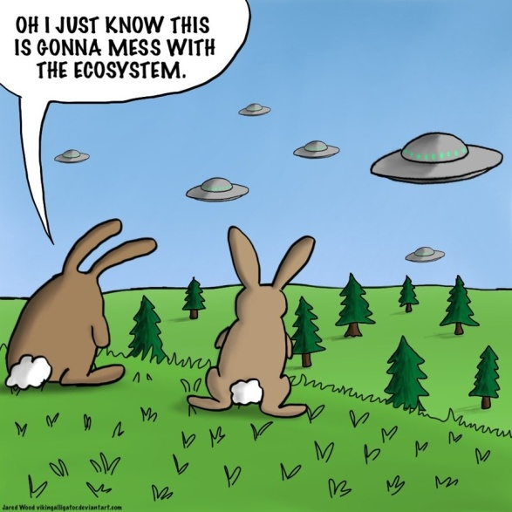
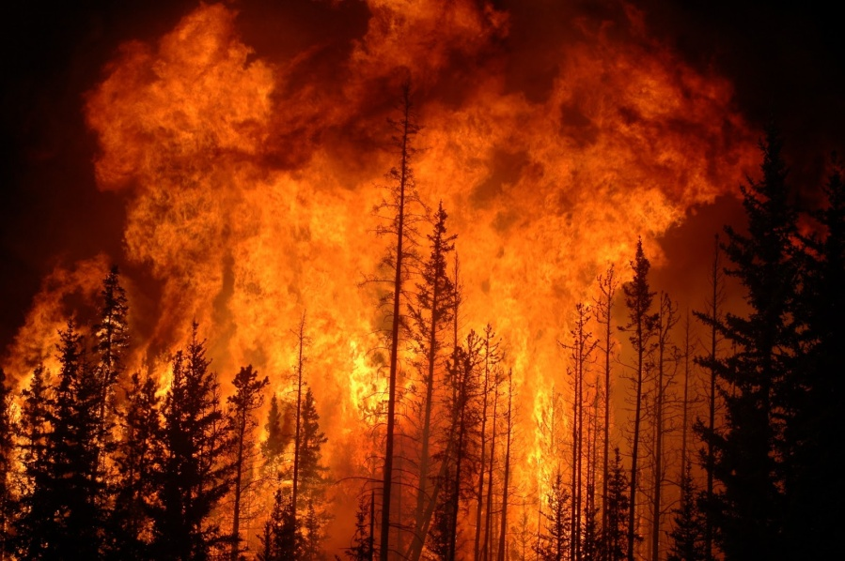
Changes to the biosphere
Mass extinction
Spread of invasive species
Agriculture troubles
Biota can regulate other earth processes
Carbon cycling, nutrient cycling,
Surface heat and water dynamics
Forest fire frequency, drought severity, flooding severity

Slide 14
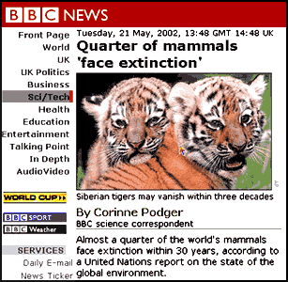
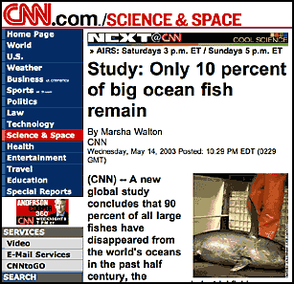
Extinction rates are troublesome

Slide 15
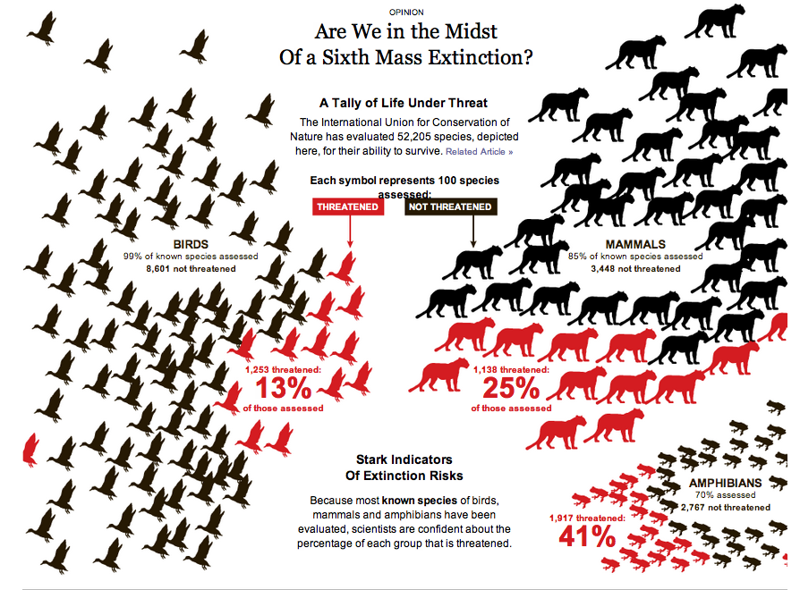

Slide 16
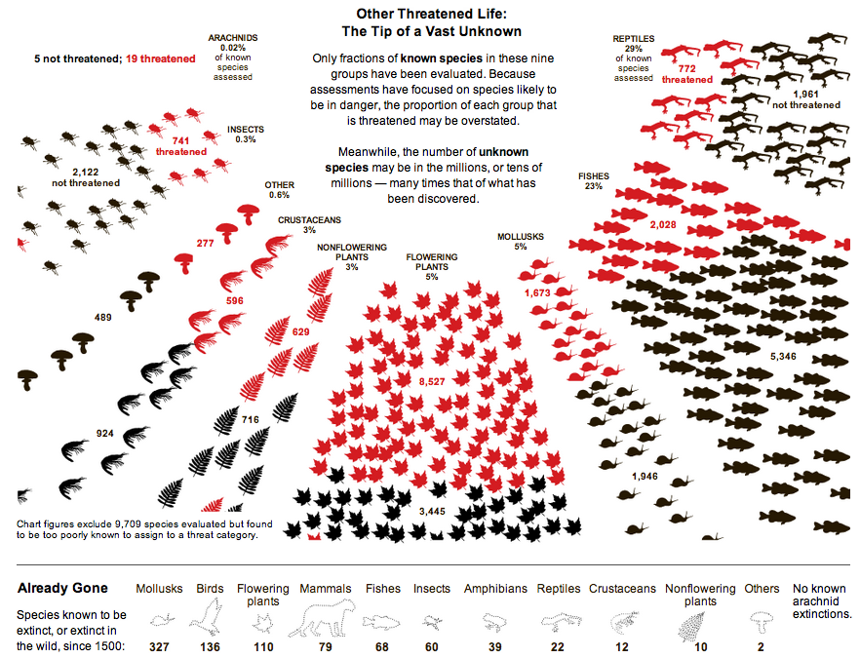

Slide 17
But why is biodiversity important?
“40 % of the world’s economy and 80% of the needs of the poor are derived from biological resources. In addition, the richer the diversity of life, the greater the opportunity for medical discoveries, economic development, and adaptive responses to such new challenges as climate change.”
Convention on Biodiversity
Important for food and resource security
Natural sustainability and evolutionary changes
Healthy ecosystems can better withstand and recover from disaster

Slide 18
Uhh oh, why did you have to bum us out?
Need to find sustainable solutions
Develop technology
Make informed decisions about what you consumer
What you eat
What you buy
What you throw away
How much water do you use
Better understand key ecosystem services
Carbon cycle
Impacts of global warming
Protect evolutionary capabilities

Slide 19
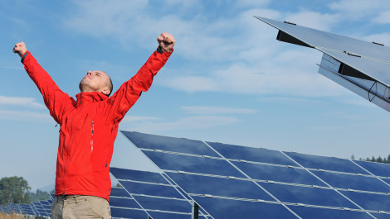
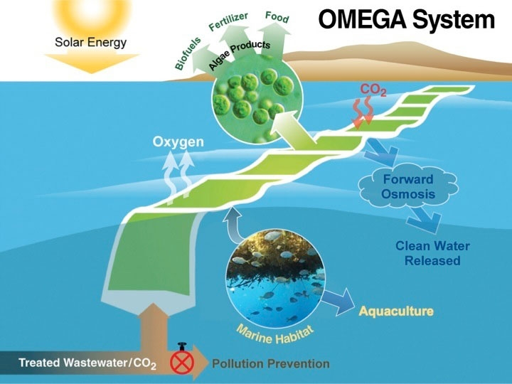
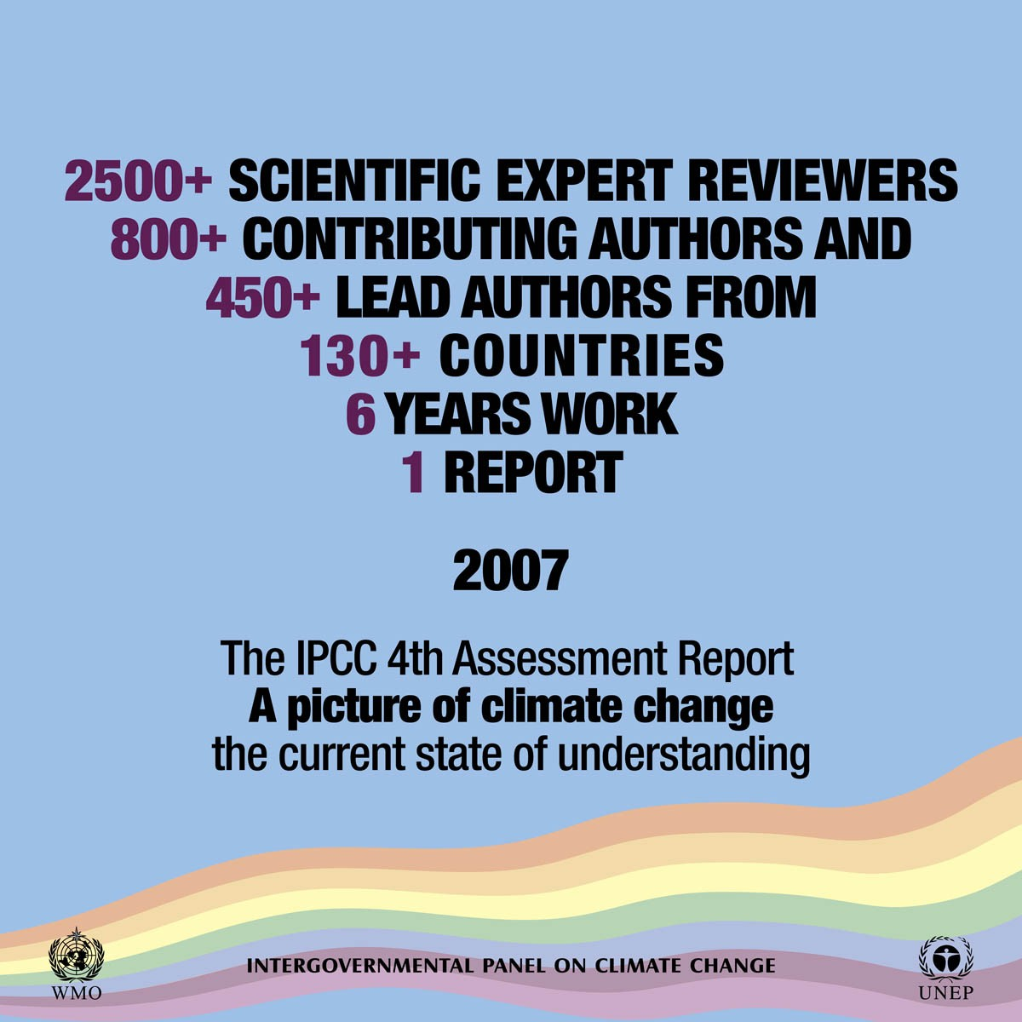
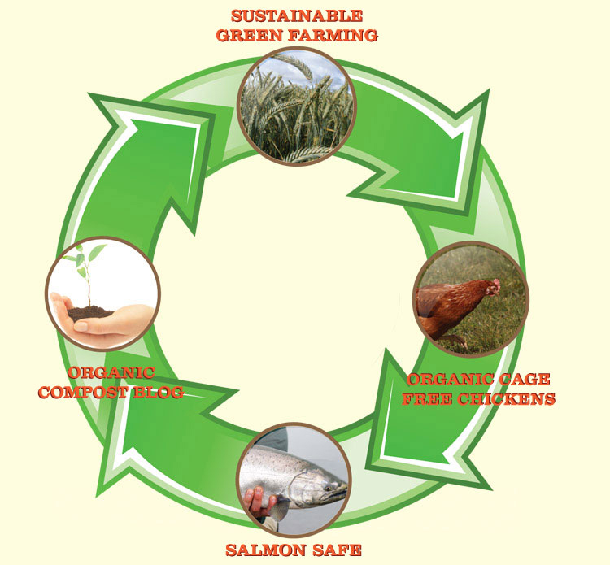

Slide 20
How can you help now?
Replace regular light bulbs with compact fluorescents
Drive less
Recycle more
Avoid products with lots of packaging
Use less hot water
Plant a tree or garden!
Turn off electronics

